Slide 1
Bayesian networks

Slide 2
Bayesian networks
A simple, graphical notation for conditional independence assertions and hence for compact specification of full joint distributions
Syntax:
  a set of nodes, one per variable
  a directed, acyclic graph (link ≈ "directly influences")
  a conditional distribution for each node given its parents:
    P (X_{i} | Parents (X_{i}))
In the simplest case, conditional distribution represented as a conditional probability table (CPT) giving the distribution over X_{i} for each combination of parent values

Slide 3

Example
Topology of network encodes conditional independence assertions:
Weather is independent of the other variables
Toothache and Catch are conditionally independent given Cavity

Slide 4
Inference in Bayesian Networks
Basic task is to compute the posterior probability for a query variable, given some observed event
  that is, some assignment of values to a set of evidence variables.
Notation:
  X denotes query variable
  E denotes the set of evidence variables E₁,…,E_{m}, and e is a particular event, i.e. an assignment to the variables in E.
  Y will denote the set of the remaining variables (hidden variables).
A typical query asks for the posterior probability P(x|e₁,…,e_{m})

Slide 5
Example
I'm at work, neighbor John calls to say my alarm is ringing, but neighbor Mary doesn't call. Sometimes it's set off by minor earthquakes. Is there a burglar?
Variables: Burglary, Earthquake, Alarm, JohnCalls, MaryCalls
Network topology reflects "causal" knowledge:
  A burglar can set the alarm off
  An earthquake can set the alarm off
  The alarm can cause Mary to call
  The alarm can cause John to call

Slide 6
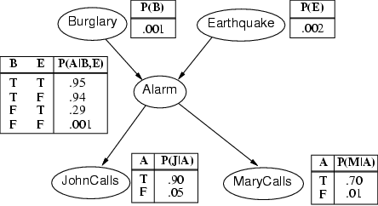
Example contd.

Slide 7
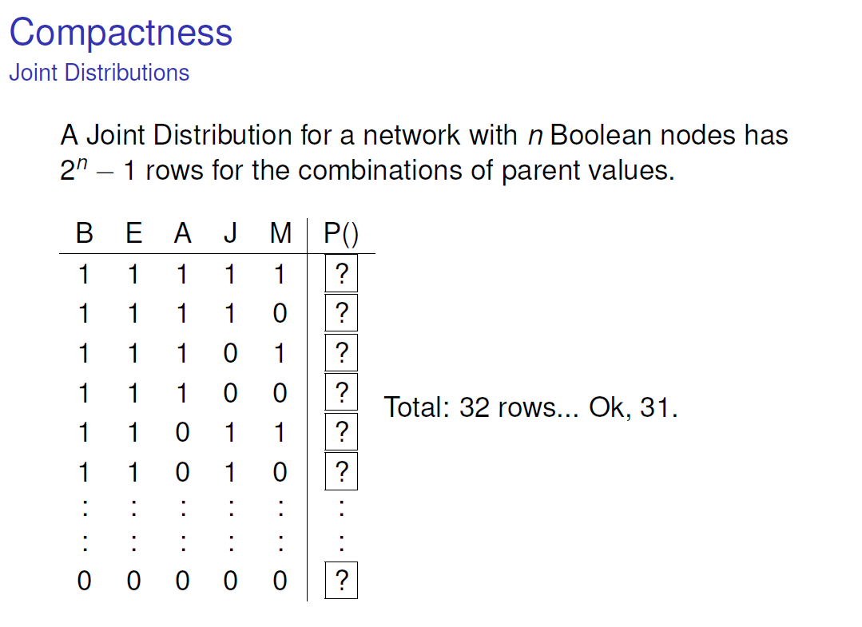

Slide 8
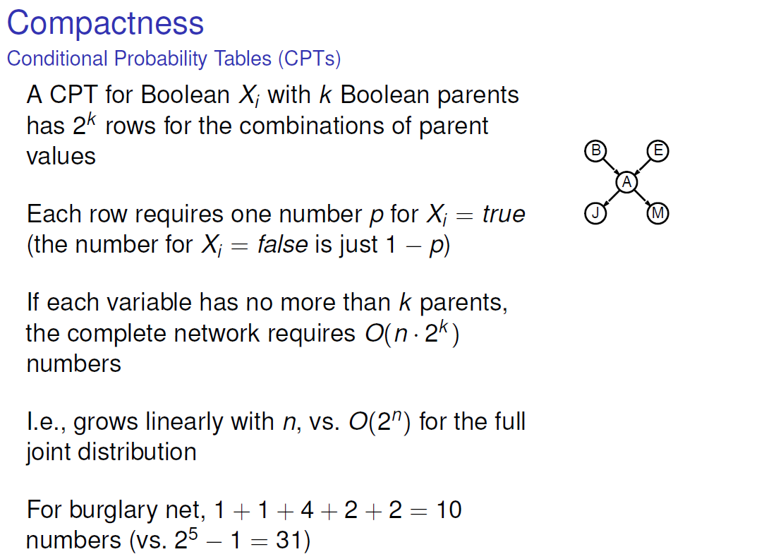


Slide 9
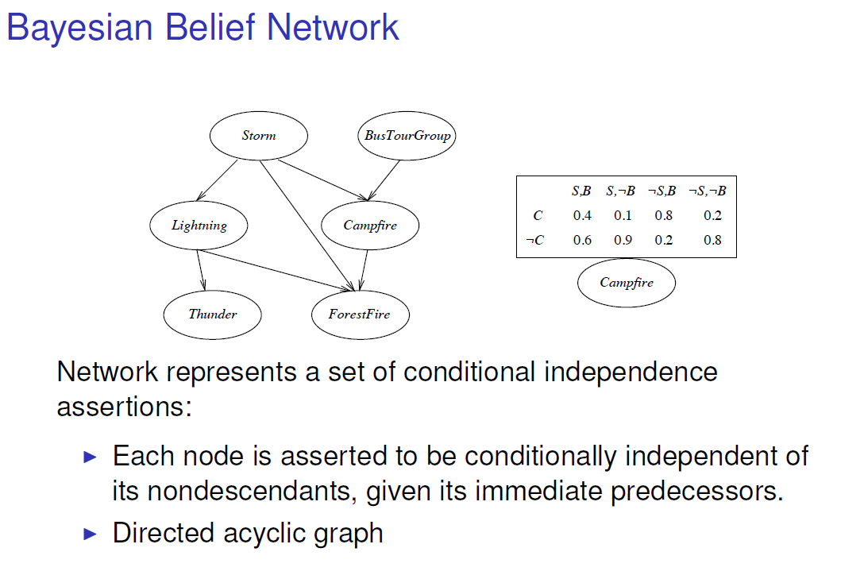

Slide 10
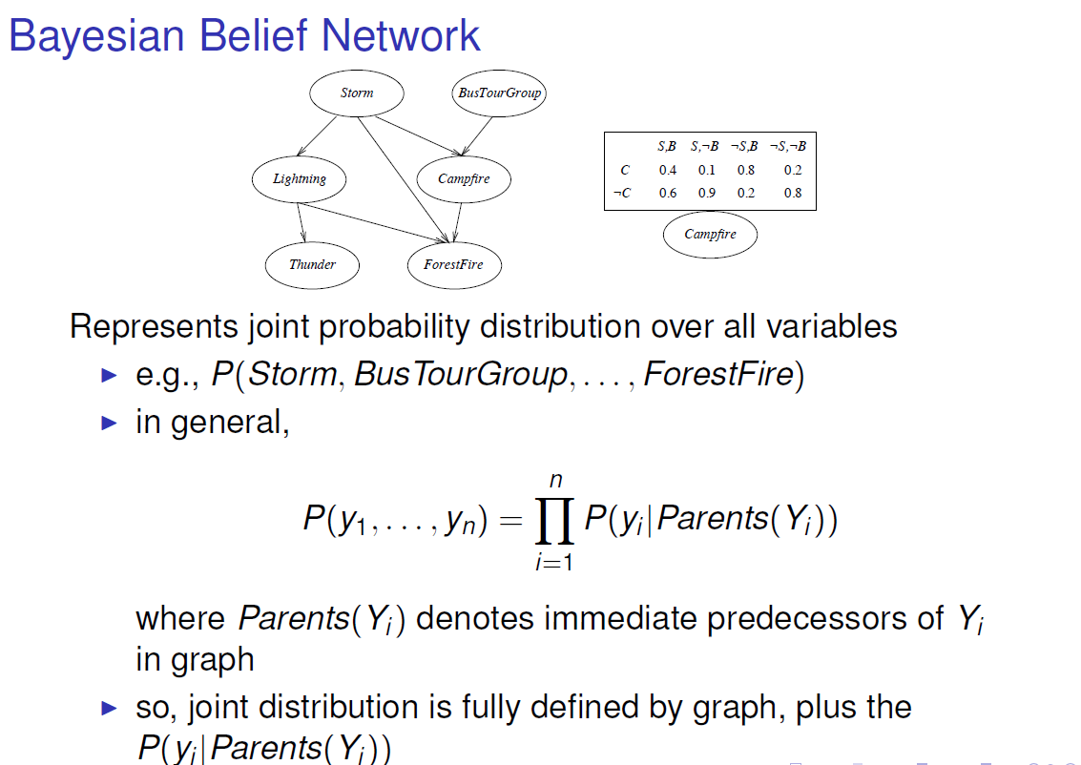

Slide 11
Example contd.

Slide 12
Example
I’m at work, neighbor John calls to say my alarm is ringing, and neighbor Mary calls. Sometimes it’s set off by minor earthquakes. Is there a burglar?
Choose:
Goal : argmax_{b∈{t,f }}P(j = t , m = t , a = t , b, e = f )
P(j = t, m = t, a = t, b = t, e = f ) = P(j = t |a = t )P(m = t |a = t )P(a = t |b = t, e = f )P(b = t )P(e = f )
vs
P(j = t, m = t, a = t, b = f , e = f ) = P(j = t |a = t )P(m = t |a = t )P(a = t |b = f, e = f )P(b = f )P(e = f )
.000628

Slide 13
Solution
P
(
J
∧
M
∧
A
∧
B
∧
~
E
) =
P
(
J
|
A
)
P
(
M
|
A
)
P
(
A
|
B
∧
~
E
)
P
( B
)
P
(~
E
)
.
9
∗
.
7
∗
.
001
∗
.
∗
=
94
.
998
.
00059
P
(
J
∧
M
∧
A
∧
~
B
∧
~
E
) =
P
(
J
|
A
)
P
(
M
|
A
)
P
(
A
|~
B
∧
~
E
)
P
(~
B
)
P
(~
E
)
.
9
∗
.
7
∗
.
001
∗
.
999
∗
.
998
=
.
00062

Slide 14
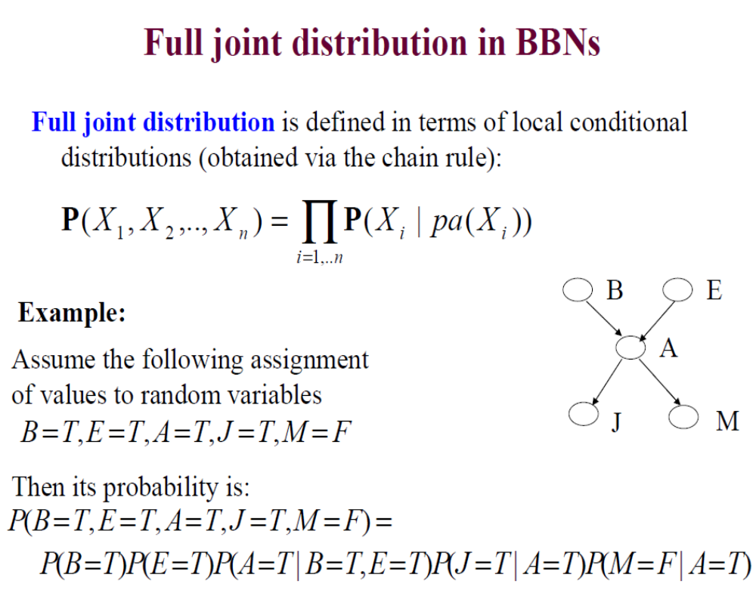

Slide 15
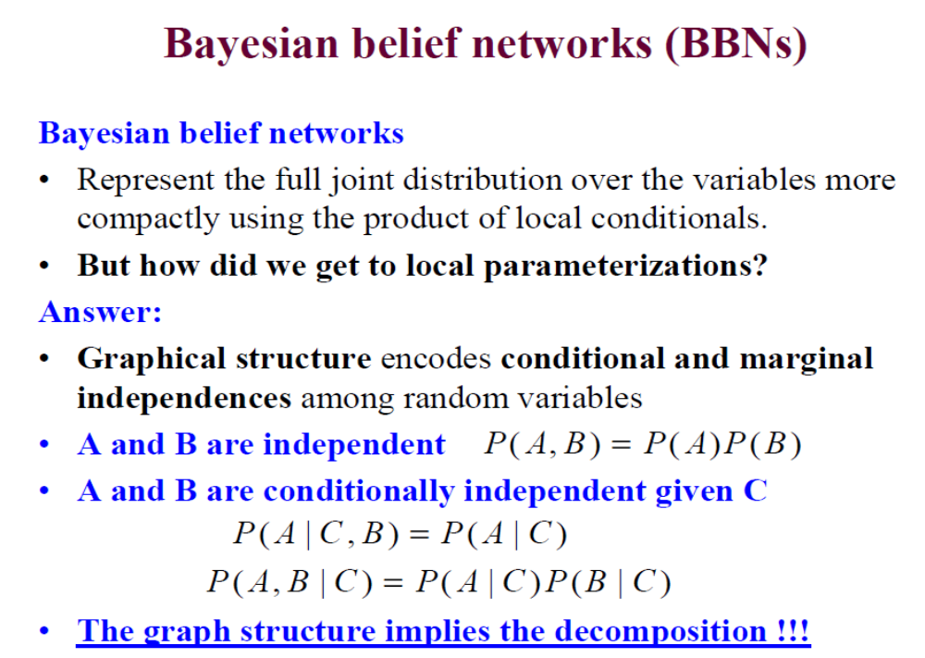

Slide 16
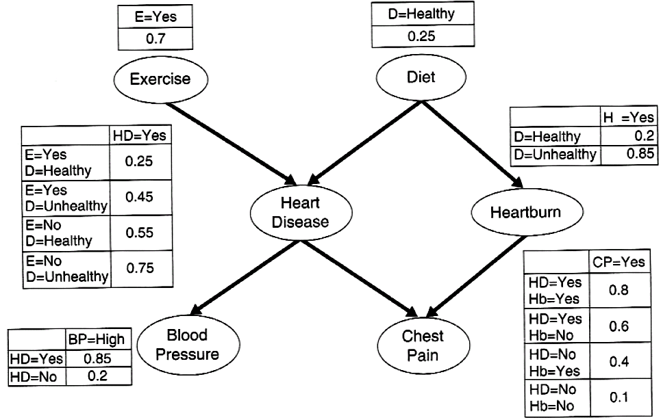
Another example
Once the right topology has been found. the probability table associated
with each node is determined.
Estimating such probabilities is fairly straightforward and is
similar to the approach used by naïve Bayes classifiers.

Slide 17
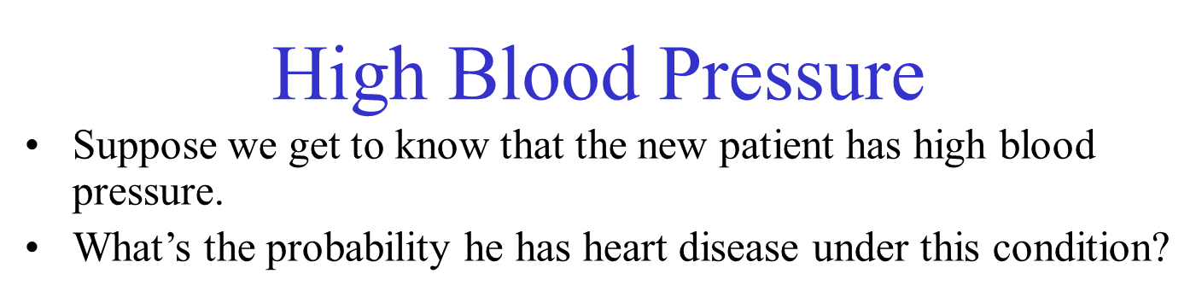

Slide 18
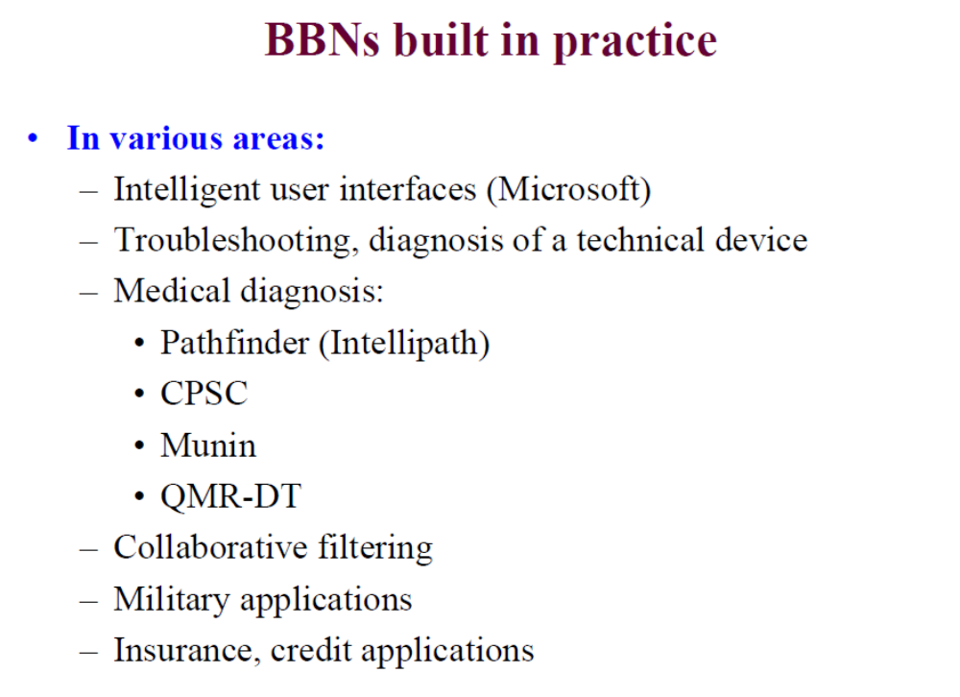

Slide 19
Summary
Bayesian networks provide a natural representation for (causally induced) conditional independence
Topology + CPTs = compact representation of joint distribution
Generally easy for domain experts to construct

